Slide 1
Programming for Data Analytics Python for Data Science
Week 1 ~ An Introduction

Slide 2
Objectives for Week 1
Course orientation, expectation
Introduction to Python (Open Source) for Data Science resources and related concepts/ideas
Technologies and platforms installation and setup
Jupyter Notebook/Python Installation
Quick introduction to the platforms
Expectations by the end of first week:
Python/Jupyter Notebook
D2L site access
Textbook copy
Notebooks and this ppt document
Commitment and understanding of the nature of the course

Slide 3
INFS 772
Credits: 3
Academic term/year: Spring 2025
Course meeting time and location: 1/13 – 5/1
Thursdays, 1:00PM - 3:30PM (in-person session & videos)
Tunheim Classroom Building (TCB), Room 109
Weekly videos are available on D2L after the classroom lectures.

Slide 4
Grading Items
4 quizzes, 10 points each, total 40%
Multiple Choices
Programming or concepts
More than 10 questions each
4 Assignments, 10 points each, total 40%
Jupyter Notebooks (.ipynb files) only
No pdf, .py, etc.
Produce identical outputs
Run all the codes and display (keep) the outputs
> 5 days after the due date, the work is not accepted
- 20% for late work 1~ 5 days after the due date.

Slide 5
New this year (2025) ~ course participation
20 % course participation is required for ALL!
Data Analytics Competition is required for all on-campus students (10%), SDSU on-campus students (20%)
Requirement for other online students is TBD

Slide 6
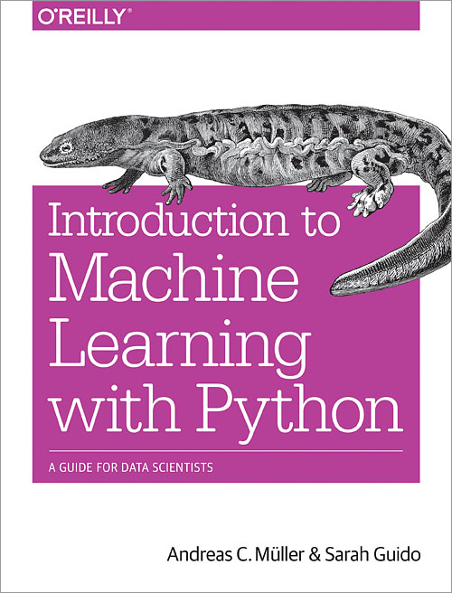
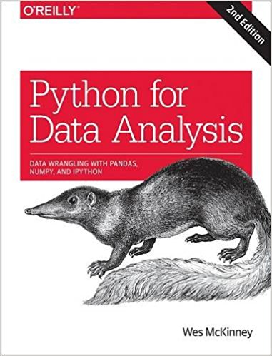
Textbooks for 772: PyData and MLPy (softcopies can be downloaded on D2L site)

Slide 7

Additional Readings for last 2 weeks: Deep Learning with Python
Chapter 1 and Chapter 3
Two pdf files

Slide 8
INFS 778 Deep Learning Summer 2025 for (advanced) students (quantitative/analytical/mathematical)

Slide 9
INFS 792 Agentic AI Systems (2025)
First 6-week summer course

Slide 10
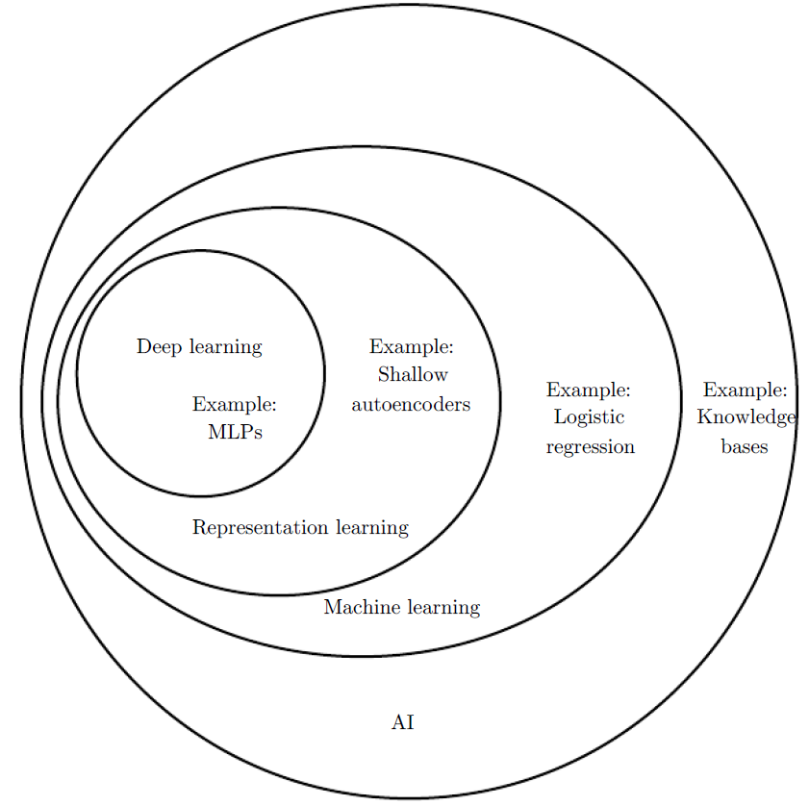
Connections among the courses?
INFS 768 Predictive Analytics for Decision Making
A foundational piece for your Data Science Pyramid
INFS 778 Deep Learning (Summer 2025)
Necessary to be a data scientist
The top piece of your Data Science Pyramid
Relatively quantitative
Closely related to the latest developments/literature
INFS 776 Business Intelligence and Visualization (Summer 2025)
Necessary skills to be a data analyst or data-powered business analyst
Perfect for less “quantitative” students
INFS 784 AI Applications (with 778 and 792)
Machine Learning, GenAI and Agentic AI and its applications

Slide 11
My courses (and major libraries covered): The Data Science Pyramid
Keras/TensorFlow
LangChain/LangGraph
Key Words:
Keras
TensorFlow
Deep Learning
Scikit-learn
Machine Learning
Python
Data Science
DL/GenAI/Agentic AI
Scikit-learn
AI Applications (Machine Learning)
Programming for Data Analytics

Slide 12
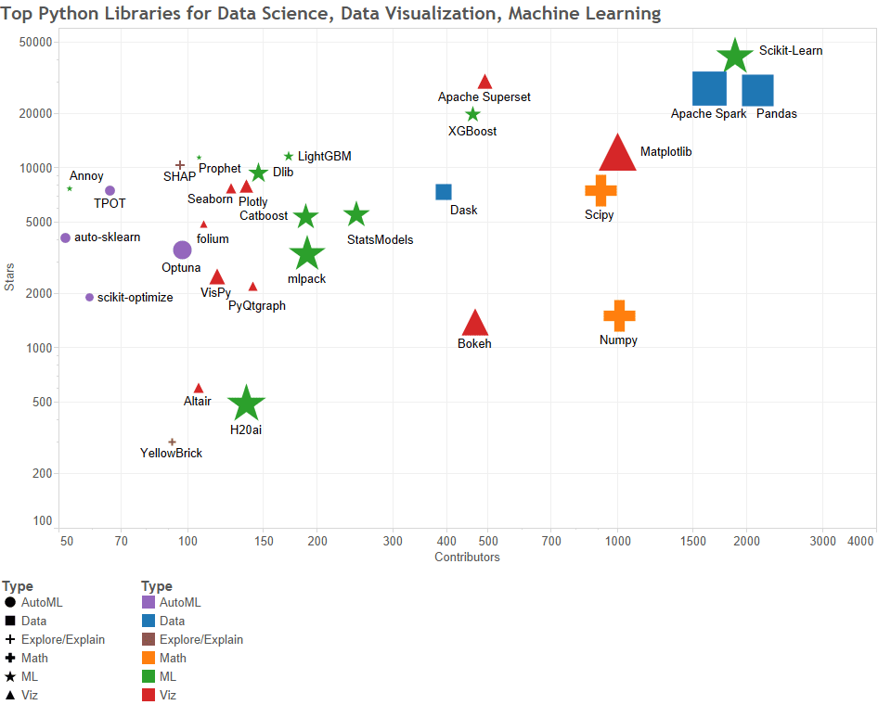
Let’s open the box of DS/ML tools
(figure updated for 2023)

Slide 13
The top 9 Python Packages You Need For Machine Learning and Data Science
Numpy
Scipy
Scikit-learn
Theano
TensorFlow
Keras
PyTorch
Pandas
Matplotlib
We are going to cover 2/3 of them and to choose the better alternative between competing ones in this class!

Slide 14
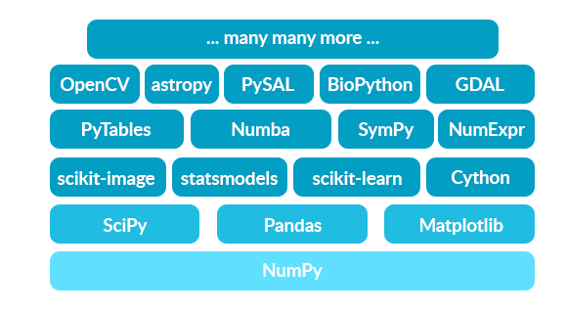
In November 2016, scikit-learn became a No. 1 open source machine learning project for Python, according to KDNuggets.
scikit-learn is a high level library designed for supervised and unsupervised machine learning algorithms.
It is built on other Python libraries, and precisely for machine learning.

Slide 15
INSTRUCTOR INFORMATION:
Name: David Zeng, PhD in Information Systems, MBA, and MSCS
Director of CBAR: https://dsu.edu/research/madison-cyber-labs/cbar.html
Office: East Hall 317
Available on Zoom if you need to talk to me
Email address: David.Zeng@dsu.edu
Office hours: Mon. Wed. Thu. 10 am ~ 1 pm.
Use Email to schedule appointments
Expect to use at least 5 hours/week to do the course work to succeed!

Slide 16
COURSE DESCRIPTION& GOALS
This course introduces Python for Data Science with an emphasis on high-level libraries and APIs.
Hand-on exercises with Python machine learning package scikit-learn.
Other essential libraries: numpy (providing ndarray for mathematical computations), pandas (providing DataFrame for data analytics), matplotlib (for visualization), and TensorFlow/Keras (for Deep Learning).
Jupyter Notebook as a highly effective learning tool.
Run Python codes
Note-taking
Attached images, hyperlinks, etc.

Slide 17
Upon completion of this course, the students should be able to:
Understand the core ideas of programming - flow control, input and output, data structures (e.g., arrays, lists, and DataFrames).
Understand the core ideas of Classes, Objects, and high-level APIs
Gain solid knowledge on some of the most popular data science modules in Python:
Numpy
Pandas
Matplotlib
Scikit-learn
TensorFlow
Keras

Slide 18
How is the course/lecture delivered?
How should you allocate my time/effort, roughly?
1/3 or less on the Basic (Python) Programming Concepts/Tools
Maybe more if you are very very far from STEM/Computers
1/3 or more on Python modules for Data Science (numpy, pandas, matplotlib, etc)
≈ 1/3 on scikit-learn
Less if you have taken INFS 768 with me
Work with Jupyter Notebook files (.ipynb) extensively
Edit (not write) codes to enhance understanding
Nature of the Assignments!
Do not solve programming issues during lectures

Slide 19
This is NOT… (What to expect)
A compute science/programming course
Not “Programming with Python”
No debugging or details of syntax of the language
No computational/memory efficiency issues
No algorithm efficiency (e.g. loop vs. vectorization) issues
A Business Analytics/Intelligence for MBA students
We are not going to just “talk about” Analytics
We are actually doing it, with Python modules/APIs
Very technical and analytical (with real data sets for Machine Learning)
For first year undergraduate students
Not all technical details would be covered step by step
You will need time/effort to learn/complete the assignments/project
You will have to be resourceful
You are expected to use google or Stackoverflow.com (with the error message) to solve basic programming problems (e.g. handle exceptions)

Slide 20
Installing Anaconda Python
We install Continuum’s Anaconda distribution by downloading the install script from the Continuum website.
https://www.anaconda.com/distribution/#download-section
The advantage of the Anaconda distribution is that lot of the essential python packages comes in bundled.
You do not have to struggle with all the dependencies synchronization.
Python version 3.10 (latest)
64-bit installer
Mid-lecture break!

Slide 21
Python!
A foundational language for Data Scientists
Python has libraries for data loading, visualization, statistics, natural language processing, image processing, and more.
This vast toolbox provides data scientists with a large array of general and special purpose functionality.
Will be THE language for INFS 772 and INFS Deep Learning (Python + TensorFlow + Keras)
Typing python in the command line will invoke the interpreter in immediate mode. We can directly type in Python expressions and press enter to get the output.
Get Python (suggested: Anaconda, Python3.6, 64­bit, https://www.continuum.io/downloads )
Or https://www.python.org/downloads/
You can also download Python3.6 separately, https://www.python.org/downloads/ and then install jupyter notebook with terminal/command prompt: pip3 install jupyter
As an existing Python user, you may wish to install Jupyter using Python’s package manager, pip, instead of Anaconda.
First, ensure that you have the latest pip; older versions may have trouble with some dependencies: pip3 install --upgrade pip

Slide 22
I recommend you use formal sources for tutorial/examples/documentations
Python3: https://docs.python.org/3/tutorial/
Jupyter Notebook: http://jupyter-notebook.readthedocs.io/en/stable/notebook.html
Scikit-learn: http://scikit-learn.org/stable/
Pandas: https://pandas.pydata.org/
Pyplot: https://matplotlib.org/tutorials/introductory/pyplot.html
Numpy: https://docs.scipy.org/doc/numpy/user/quickstart.html

Slide 23
Checking Python Install
In order to check the Python install, we issue the following commands in the Anaconda Prompt. (cmd mode)
python --version
python
Save the following into a file named hello.py with notepad
name = input("What's your name? ")
print("Nice to meet you " + name + "!")
age = input("Your age? ")
print("So, you are already " + age + " years old, " + name + "!")
Use python hello.py in cmd mode or import hello from python prompt to run the Python script
Use help() whenever needed
Use quit() to quit

Slide 24
Python script (.py), IPython, !type, %run
Use your notepad (or IDLE) to save this
import sys
print('version is', sys.version)
into a file sys-version.py
This is a Python script
Editable with a text editor such as Notepad
Open your IPython mode (>ipython from cmd)
Use this !type sys-version.py to stream the file’s content
Run the script with %run sys-version.py
quit() to quit
Again, outside of python prompt, you just use python to run Python scripts

Slide 25
Mini-Exercise: run python script under different modes (about 5 mins)
1. create a python script called myplot.py
import matplotlib.pyplot as plt
import numpy as np
x = np.linspace(0, 10, 100)
plt.plot(x, np.sin(x))
plt.plot(x, np.cos(x))
plt.show()
2. > python myplot.py
3. type myplot.py
4. Run ipython
5. [in]: !type myplot.py
6. [in]: %run myplot.py
7.> python
8. >>>import myplot

Slide 26
Testing Jupyter Notebook
The Jupyter Notebook is an interactive environment for running code in the browser.
It is a great tool for exploratory data analysis and is widely used by data scientists.
A foundational tool for learning, research, computing, and data-powered communications.
The primary tool for INFS 772 ~ Python Programming for Data Analytics.
Download the introduction_to_notebook file from D2L course site under Python Files.
We are going to test the Jupyter Notebook file.
Do not open Jupyter Notebook files with Notepad! Make sure your jupyter notebook kernel is running and then open your notebook files from the browser.

Slide 27
Work with a Notebook (browser-based)
Start a Notebook
Open terminal/command prompt jupyter notebook
Or you can open it via the menu of Anaconda programs
Notebook will open at http://127.0.0.1:8888
Exit by closing the browser, then typing Ctrl+C in the terminal window
Introduction to Notebook (.ipynb) file

Slide 28
Week 2 Outline
Intro to Python and Jupyter Notebook
Get Started with Python
Light Introductions to the libraries
A Light Introduction to Python II
List, Function, Class/Object, indentation, for loop
Introduction to Jupyter notebook II
Course schedule
Your job as a data scientist with the example of VGG-16
Instructions for Quiz 1 and Assignment 1

Slide 29
Week 3
Quiz 1 (numpy basics) is due on 2/5 (Sun.)
Assignment 1 is due on 2/9 (Thur.)
Light introductions to the libraries
Numpy basics and more

Slide 30

Light introductions to the libraries
Numpy
NumPy is a very popular python library for large multi-dimensional array and matrix processing, with the help of a large collection of high-level mathematical functions.
It is very useful for fundamental scientific computations in Machine Learning.
It is particularly useful for linear algebra, and random number capabilities.
High-end libraries like TensorFlow uses NumPy internally for manipulation of Tensors.
https://numpy.org/doc/stable/user/absolute_beginners.html

Slide 31
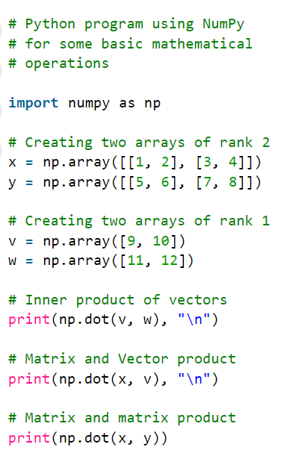
219
[29 67]
[[19 22]
[43 50]]

Slide 32

Pandas
Pandas is a popular Python library for data analysis.
As we know that the dataset must be prepared before training. In this case, Pandas comes handy as it was developed specifically for data extraction and preparation.
It provides high-level data structures, such as DataFrame, and wide variety tools for data analysis.
It provides many inbuilt methods for grouping, combining and filtering data.
https://pandas.pydata.org/docs/getting_started/intro_tutorials/index.html

Slide 33
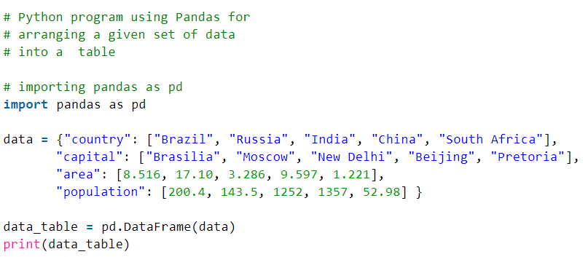
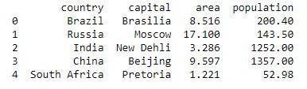
{}: dict
[]: list
“”: string

Slide 34
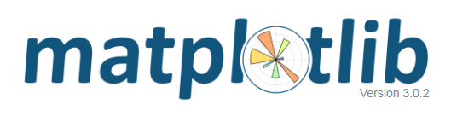
matplotlib
Matplotlib is a very popular Python library for data visualization.
Like Pandas, it is not directly related to Machine Learning.
It particularly comes in handy when a programmer wants to visualize the patterns in the data.
It is a 2D plotting library used for creating 2D graphs and plots. A module named pyplot makes it easy for programmers for plotting as it provides features to control line styles, font properties, formatting axes, etc.
It provides various kinds of graphs and plots for data visualization, viz., histogram, error charts, bar charts, etc.
https://matplotlib.org/contents.html

Slide 35
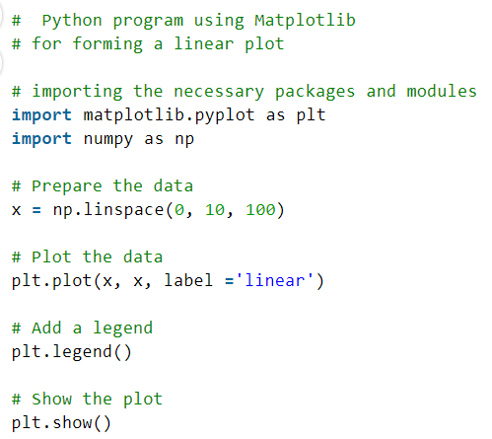
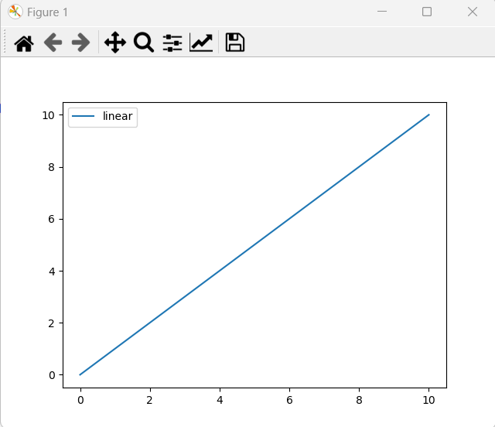

Slide 36

Scikit-learn
Scikit-learn is one of the most popular ML libraries for classical ML algorithms.
It is built on top of two basic Python libraries, NumPy and SciPy.
Scikit-learn supports most of the supervised and unsupervised learning algorithms.
Scikit-learn can also be used for data-mining and data-analysis, which makes it a great tool who is starting out with ML.
https://scikit-learn.org/stable/tutorial/basic/tutorial.html

Slide 37
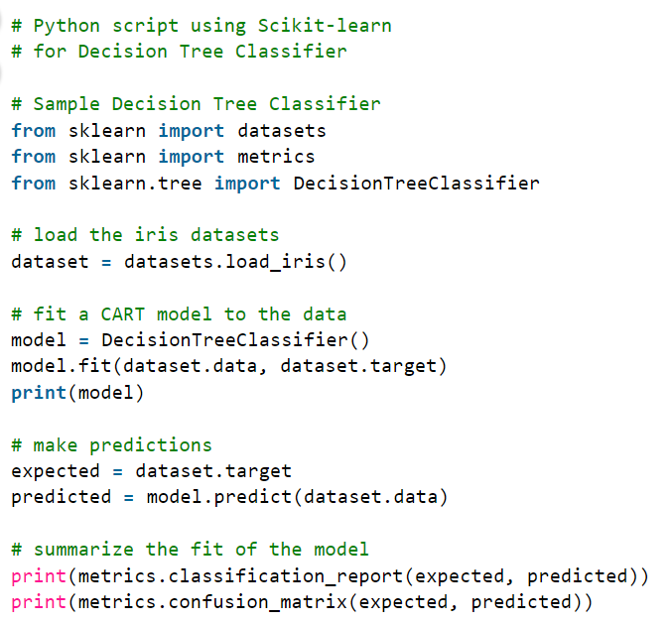
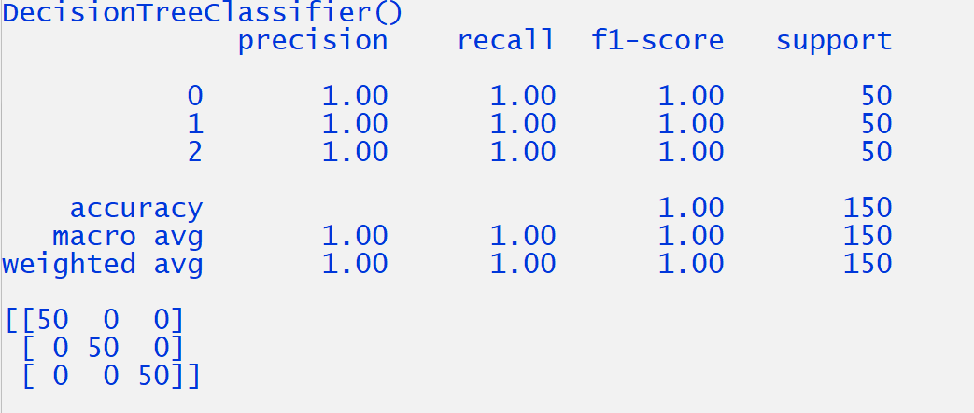

Slide 38

TensorFlow 2
TensorFlow is a very popular open-source library for high performance numerical computation developed by the Google Brain team in Google.
As the name suggests, Tensorflow is a framework that involves defining and running computations involving tensors.
It can train and run deep neural networks that can be used to develop several AI applications.
TensorFlow is widely used in the field of deep learning research and application, thus the primary library in my summer Deep Learning class, INFS 778.
https://www.tensorflow.org/tutorials/quickstart/beginner

Slide 39
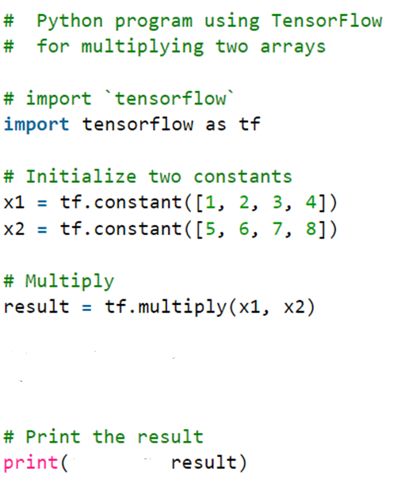
[ 5 12 21 32]
tf.Tensor([ 5 12 21 32], shape=(4,), dtype=int32)

Slide 40

Keras
Keras is a very popular Machine Learning library for Python.
It is a high-level neural networks API capable of running on top of TensorFlow, CNTK, or Theano.
It can run seamlessly on both CPU and GPU.
Keras makes it really for ML beginners to build and design a Neural Network.
One of the best thing about Keras is that it allows for easy and fast prototyping, for research and experiments, thus our choice to start build DL models.
https://www.tensorflow.org/guide/keras/sequential_model

Slide 41
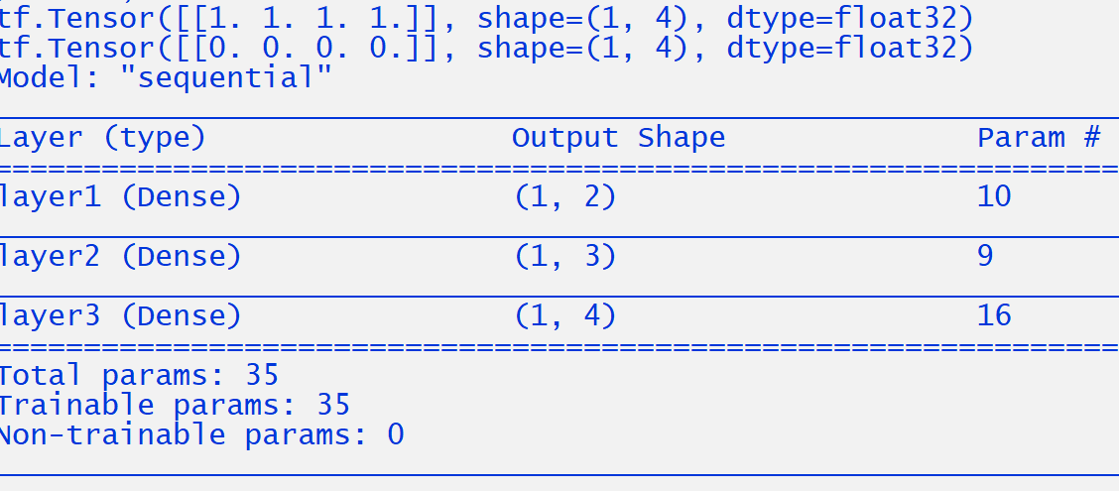
import tensorflow as tf
from tensorflow import keras
from tensorflow.keras import layers
# Define Sequential model with 3 layers
model = keras.Sequential(
[
layers.Dense(2, activation="relu", name="layer1"),
layers.Dense(3, activation="relu", name="layer2"),
layers.Dense(4, name="layer3"),
]
)
# Call the model on a test input
x = tf.ones((1, 4)) # inputs
y = model(x) # outputs
print(x)
print(y)
# Once a model is "built", you can call its summary() method to display its contents
model.summary()
Why is y all zeros?

Slide 42
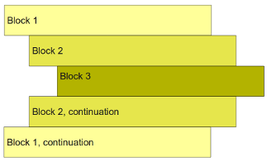
Some Python Basics
Code Block Control by Indentation (default 4 spaces)
python lists are 0-indexed. The first element is 0, second is 1, so on. So, if the there are n elements in a list, the last element is n-1.
Element Access
You can access single elements using the name followed by a number in []. Like so:
example[0] # first element
example[1] # second element, so on
You can access the elements at the end by adding a minus.
example[-1] # n-th (last) element.
example[-2] # n-1-th element

Slide 43
Slicing (1-d examples)
example = [1,2,3,4,5] # create a list
print (example[0:5]) # Whole list, prints [1,2,3,4,5]
print (example[1:5]) # prints [2,3,4,5]
print example[4:5] # prints [5]
If you leave out the start index, it's assumed to be zero. If you leave out the end index it's assumed to be the length of the list. So:
print (example[:5]) # treated as example[0:5]; prints [1,2,3,4,5]
print (example[3:]) # treated it as example[3:5]; prints [4,5]
print (example[:]) # treated as example[0:5]; prints [1,2,3,4,5]

Slide 44
Key skills (my definition) for Data Scientists
1. Quantitative,
2. Utilizing open-source/high level libraries, APIs, and pre-trained models,
3. Communicating verbally and visually,
4. Learning the latest advances.

Slide 45
Indenting code blocks (and for loop)
from math import sqrt
n = input("Maximum Number? ")
n = int(n)+1
for a in range(1,n):
for b in range(a,n):
c_square = a**2 + b**2
c = int(sqrt(c_square))
if ((c_square - c**2) == 0):
print(a, b, c)

Slide 46
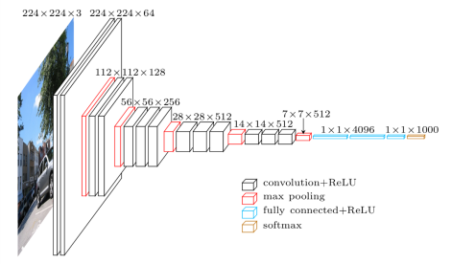
VGG-16: a 16-hidden-layer deep neural network
Your job as a data scientist:
Understand the problem and your data (business processes)
Understand the nature of the model you use (how it works)
Utilize pre-trained model and APIs
Fine-tune the learning process with a state-of-the-art optimizer
Evaluate the model
Test the model with your new data
Predict! Or deploy the model
Communicate the results!

Slide 47
Instructions on Self-paced Exercise 1
1. Download the data files from the UCI ML data depository site before you can use them in your python program.
Make sure they are in your working directory (for me, it is C:\Users\dzeng\772 Programming for Data Analytics)
And you may want to use
import os os.getcwd()
to display it for you if you are not sure. This is where your jupyter notebook file is.
They are “text” files but make sure they have the correct extensions (.data and .attributes) when you save them. More specifically, change the .names file into .attributes when you save it in your machine: https://archive.ics.uci.edu/ml/machine-learning-databases/mushroom/

Slide 48
2. Download and install a separate module call “simple_ml”.
It is on D2L under Course Files, you need to download it into either (for me)
C:\Users\dzeng\AppData\Local\Programs\Python\Python36\Lib
If you installed Python separately, or
C:\Users\dzeng\AppData\Local\Continuum\Anaconda3\Lib\site-packages\
If you use Anaconda3
3. The codes in the cells are highly connected. You (almost) have to run them one by one from the beginning in order to run the cells related to assignment 1 later in the file.
4. Remove the two exception-handling examples in the file

Slide 49
Outline for Week 3
Review: basic data structures: list, tuple, dict
for loop
Functions (lambda function/operator)
Classes
Self-paced Exercises 1
Defining and calling functions
Starting point:
single_instance_list : a list of attribute values of a single instance
attribute_names : a list of attribute names
File I/O

Slide 50
Review
List
Lists are very similar to strings, except that each element can be of any type.
The syntax for creating lists in Python is [...]
The indexing operator consists of square brackets [] rather than parentheses
indexing starts at 0
Adding, inserting, modifying, and removing elements from lists (mutate the list)
Dictionaries
Dictionaries are also like lists, except that each element is a key-value pair. The syntax for dictionaries is {key1 : value1, ...}

Slide 51
Classes
Classes provide a means of bundling data and functionality together.
Creating a new class creates a new type of object, allowing new instances of that type to be made.
Each class instance can have attributes attached to it for maintaining its state.
Class instances can also have methods (defined by its class) for modifying its state.
Class objects support two kinds of operations: attribute references and instantiation.

Slide 52
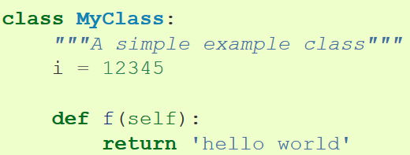
attribute references and instantiation
Attribute references use the standard syntax used for all attribute references in Python: obj.name.
then MyClass.i and MyClass.f are valid attribute references, returning an integer and a function object, respectively.
Class instantiation uses function notation.
x = MyClass()
Creates a new instance of the class and assigns this object to the local variable x.

Slide 53
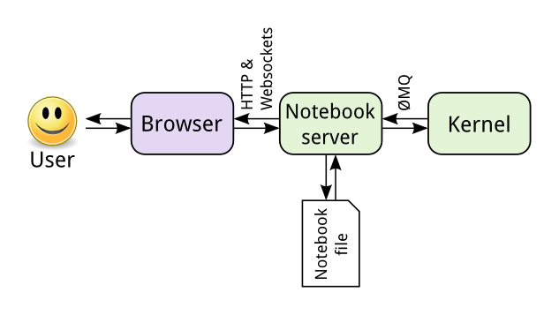
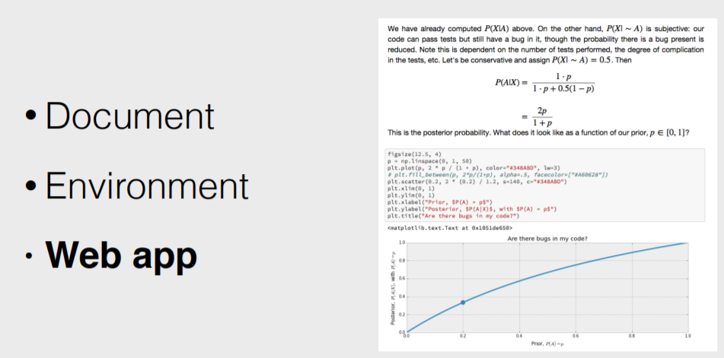
What is Jupyter Notebook?
Jupyter Notebook is a client-server application used for running notebook documents in the browser. Notebook documents are documents able to contain both executable resource codes/outputs and rich text elements such as paragraphs, equations, and so on.
When you save it, this is sent from your browser to the notebook server, which saves it on disk as a JSON file with a .ipynb extension.

Slide 54
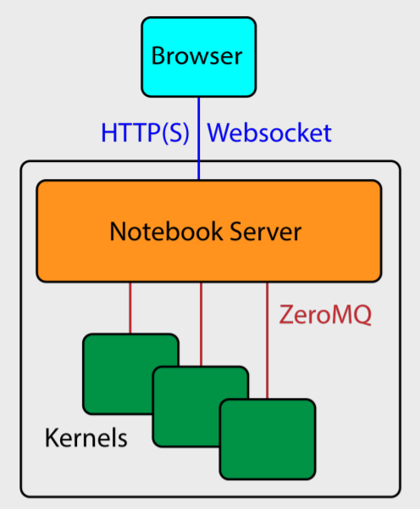
What is a Notebook Server? What is a Kernel?
A Notebook Server: The notebook server, not the kernel, is responsible for saving and loading notebooks, so you can edit notebooks even if you don’t have the kernel for that language—you just won’t be able to run code.
A Kernel: a program that runs the user’s code. The kernel doesn’t know anything about the notebook document: it just gets sent cells of code to execute when the user runs them.

Slide 55
The kernel
The kernel's state persists over time and between cells — it pertains to the document as a whole and not individual cells.
For example, if you import libraries or declare variables in one cell, they will be available in another.
Restart: restarts the kernel, thus clearing all the variables etc. that were defined.

Slide 56
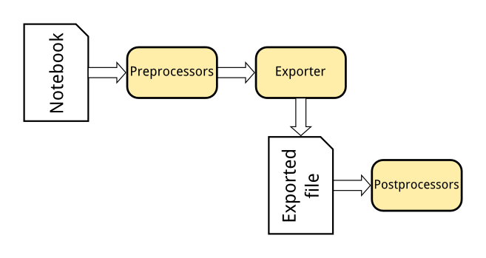
Exporting notebooks to other formats
The Nbconvert tool in Jupyter converts notebook files to other formats, such as HTML, LaTeX, or reStructuredText. This conversion goes through a series of steps:
Preprocessors modify the notebook in memory. E.g. ExecutePreprocessor runs the code in the notebook and updates the output.
An exporter converts the notebook to another file format. Most of the exporters use templates for this.
Postprocessors work on the file produced by exporting.

Slide 57
Nbviewer
If you already have somewhere to host your Jupyter Notebooks online, be it GitHub or elsewhere, NBViewer will render your notebook and provide a shareable URL along with it. Provided as a free service as part of Project Jupyter, it is available at nbviewer.jupyter.org.
The nbviewer website uses nbconvert with the HTML exporter.
When you give it a URL, it fetches the notebook from that URL, converts it to HTML, and serves that HTML to you.
Mini-exercise: < 1 min
Go to nbviewer.jupyter.org
Enter https://github.com/google-research/bert/blob/master/predicting_movie_reviews_with_bert_on_tf_hub.ipynb
Go!

Slide 58
Installing Anaconda Python/Jupyter Notebook
We install Continuum’s Anaconda distribution by downloading the install script from the Continuum website.
https://www.anaconda.com/distribution/#download-section
The advantage of the Anaconda distribution is that lot of the essential python packages comes in bundled.
You do not have to struggle with all the dependencies synchronization.
Python version 3.7 (latest)
64-bit installer
Mini-break!

Slide 59
Testing Jupyter Notebook
The Jupyter Notebook is an interactive environment for running code in the browser.
It is a great tool for exploratory data analysis and is widely used by data scientists.
A foundational tool for learning, research, computing, and data-powered communications.
Download the introduction_to_notebook file
We are going to test the Jupyter Notebook file.
Do not open Jupyter Notebook files with Notepad! Make sure your jupyter notebook kernel is running and then open your notebook files from the browser.

Slide 60
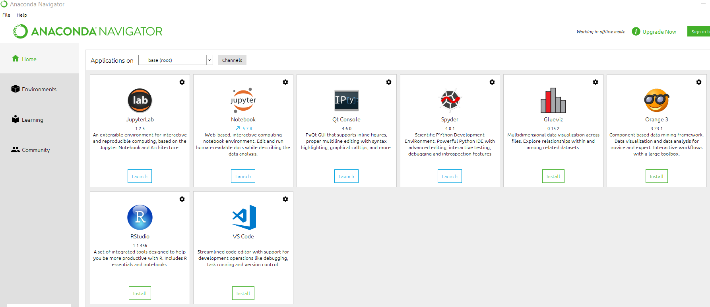

Slide 61
Work with a Notebook (browser-based)
Start a Notebook
Open terminal/command prompt jupyter notebook
Or you can open it via the menu of Anaconda programs
Notebook will open at http://127.0.0.1:8888
Exit by closing the browser, then typing Ctrl+C in the terminal window
Introduction to Notebook (.ipynb) file
Exercise 2: 5 mins
Intro to Jupyter Notebook II (.ipynb) file
Exercise 3&4: 5 ~ 10 mins

Slide 62
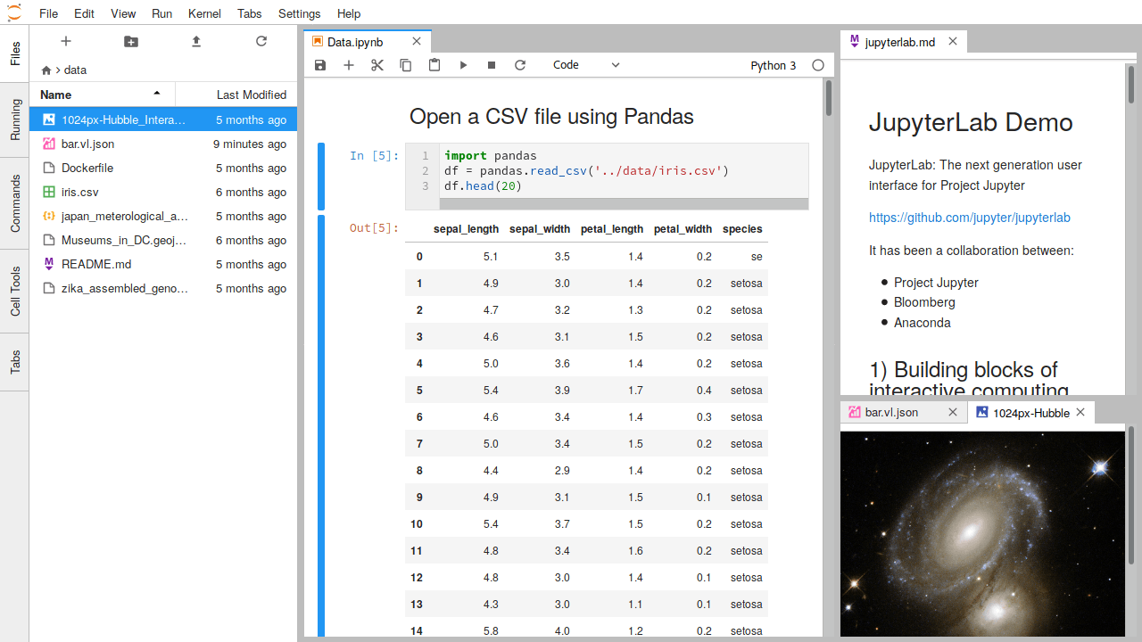
What is JupyterLab?
JupyterLab enables you to work with documents and activities such as Jupyter notebooks, text editors, terminals, and custom components in a flexible, integrated, and extensible manner.
You can arrange multiple documents and activities side by side in the work area using tabs and splitters.

Slide 63
JupyterLab
A “next-generation web interface” for the Jupyter notebook — one that extends the familiar notebook metaphor with drag-and-drop functionality, as well as file browsers, data viewers, text editors and a command console.
Whereas the standard Jupyter notebook assigns each notebook its own kernel, JupyterLab creates a computing environment that allows these components to be shared.
Thus, a user could view a notebook in one window, edit a required data file in another, and log all executed commands in a third — all within a single web-browser interface.

Slide 64
JupyterLab for Interactive Computing
Documents and activities integrate with each other, enabling new workflows for interactive computing, for example:
Code Consoles provide transient scratchpads for running code interactively, with full support for rich output. A code console can be linked to a notebook kernel as a computation log from the notebook, for example.
Kernel-backed documents enable code in any text file (Markdown, Python, R, LaTeX, etc.) to be run interactively in any Jupyter kernel.
Notebook cell outputs can be mirrored into their own tab, side by side with the notebook, enabling simple dashboards with interactive controls backed by a kernel.
Multiple views of documents with different editors or viewers enable live editing of documents reflected in other viewers. For example, it is easy to have live preview of Markdown, Delimiter-separated Values, or Vega/Vega-Lite documents.

Slide 65
JupyterLab: A Quick Demo
JupyterLab also offers a unified model for viewing and handling data formats.
JupyterLab understands many file formats (images, CSV, JSON, Markdown, PDF, Vega, Vega-Lite, etc.) and can also display rich kernel output in these formats.
Exercise 6: 2~3 mins
1. copy the following codes & create a Python script file “myplot.py”
2. create a new console & %run myplot.py
import matplotlib.pyplot as plt
import numpy as np
x = np.linspace(0, 10, 100)
plt.plot(x, np.sin(x))
plt.plot(x, np.cos(x))
plt.show()

Slide 66
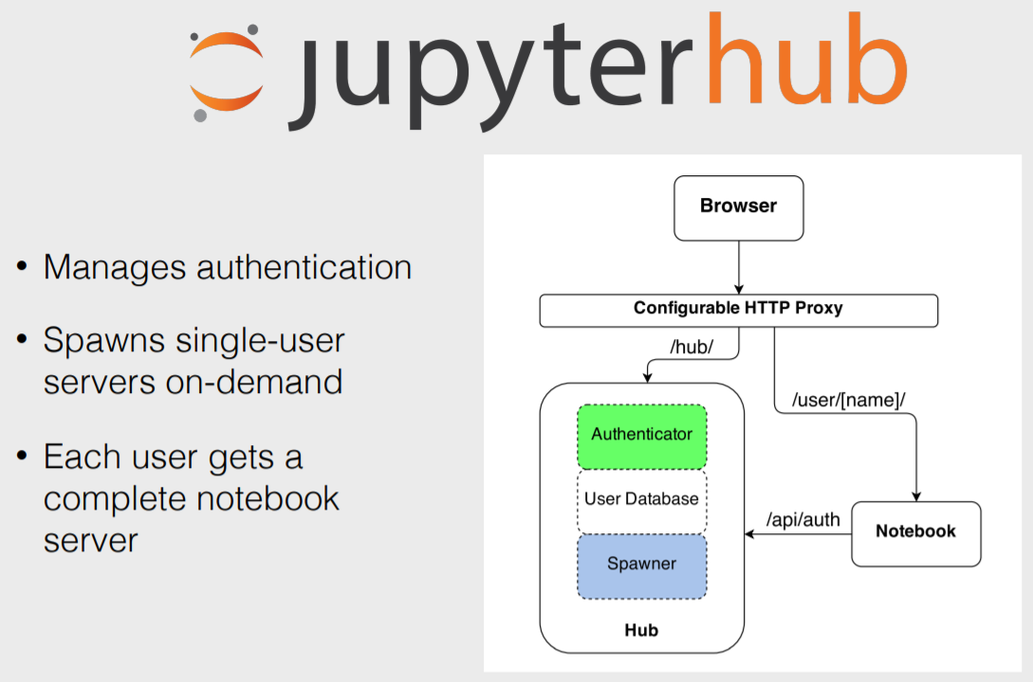
What is JupyterHub?
A service that allows institutions to provide Jupyter notebooks to large pools of users
E.g., can be used to ensure that all students on my data science course have identical computing environments

